Slide 1

Lending Club Case Study
Group Members-
Ashish Kumar Yadav
Jibin Kaitharath Baby

Slide 2
Abstract
Lending Club is a consumer finance company which specializes in lending various types of loans to urban customers.
When company receives a loan application, it must make decision for loan approval based on the applicant’s profile.
Our objective here is to analyse and understand the driving factors (strong indicators) behind loan defaults.

Slide 3
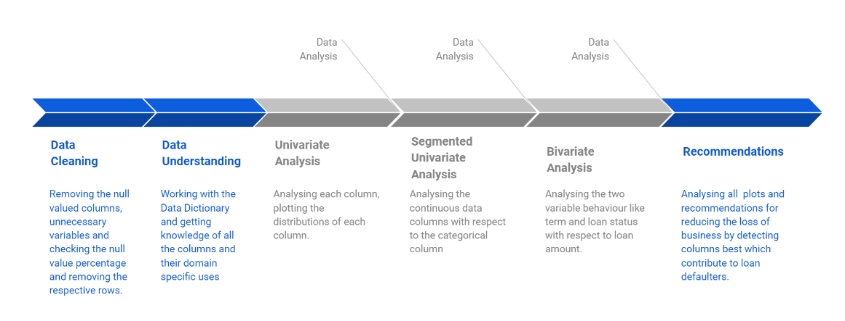
Approach to solve problem

Slide 4
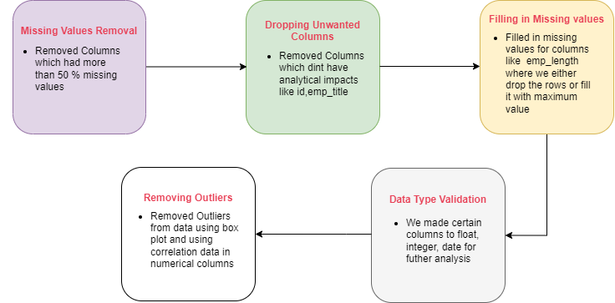
Data Cleaning Process

Slide 5
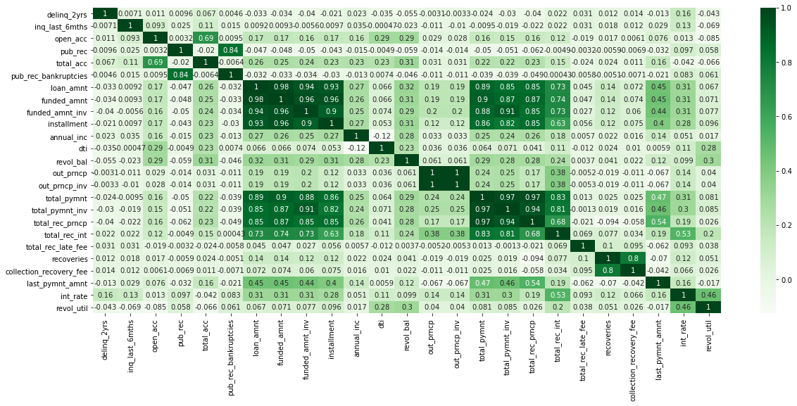
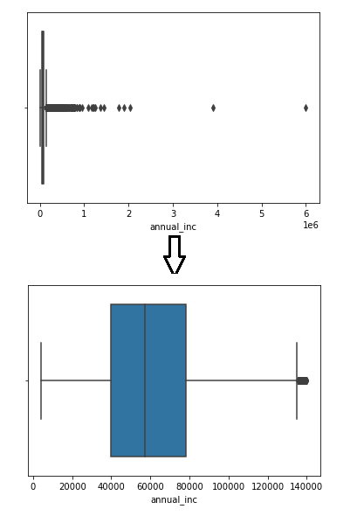
Correlation Based Outlier Removal

Slide 6
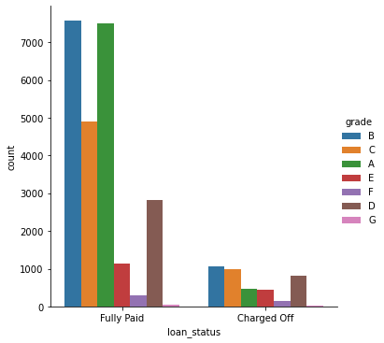
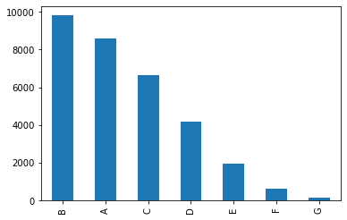
Grade Level Analysis
Most of the loans from Grade A-D loans comprising of nearly 76% of volume, with B being the highest.
We can see that Grade loans F and G are least preferred.
In comparison to Loan Status we can see that Grade D loans have higher chances of getting defaulted.

Slide 7
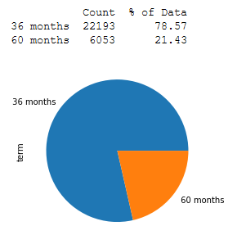
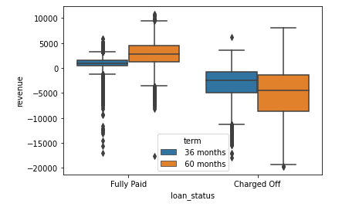
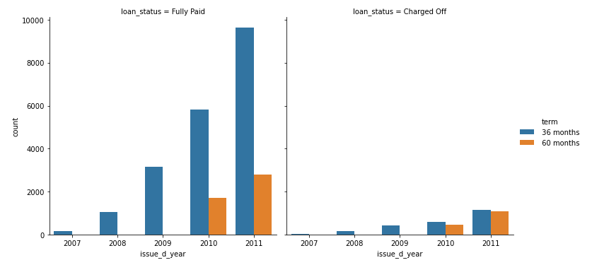
Loan Term Analysis
Majority of the loan (78%) were provided for 36 months, and 21% loans were provided for 60 months
Magnitude of Charge Off is more in the 60 months scenario and has affects on the revenue.
60 months loan that started in 2010 has higher profits as well as extreme losses compared to 36 months.

Slide 8
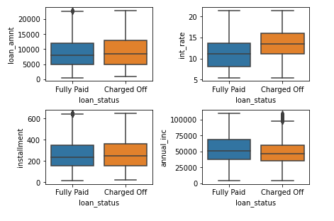
Loan Statistical Analysis
Higher the Interest rates more the probability it will be Charged off.
Higher the Annual Income more the chances it will be Fully Paid.
Loan Amount and Installments doesn’t seem to have major impact on Loan being Defaulted.

Slide 9
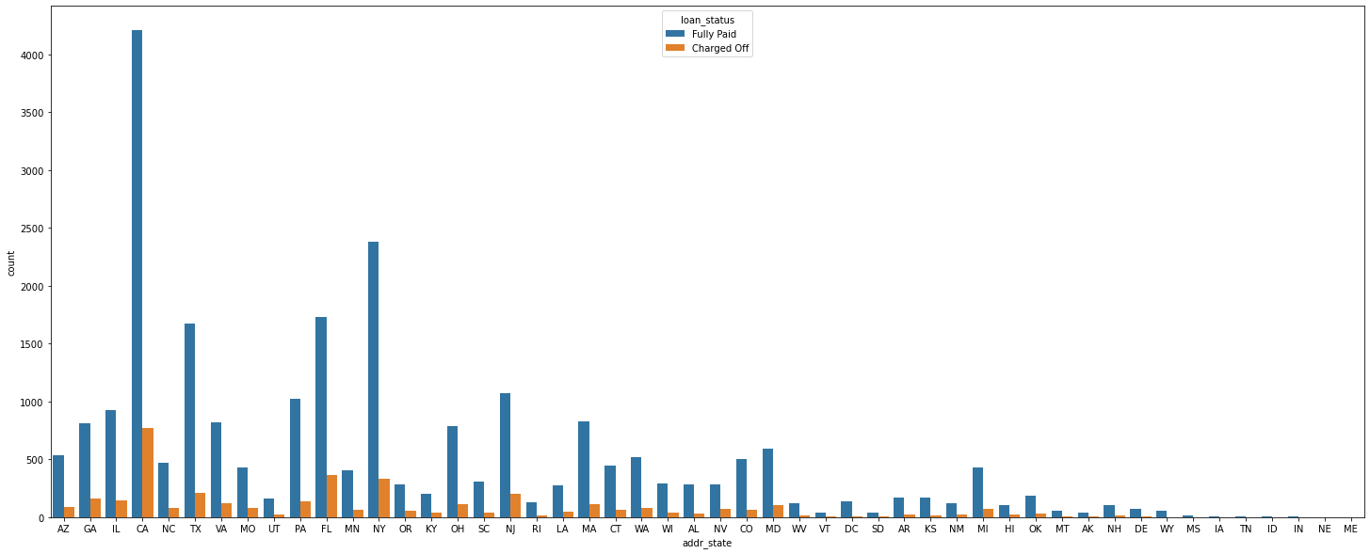
State Wise Analysis
Maximum no of loans are allocated to California(CA) with most being Fully Paid.
Defaulter's count is also more in CA, so with better scrutiny it can be reduced.

Slide 10
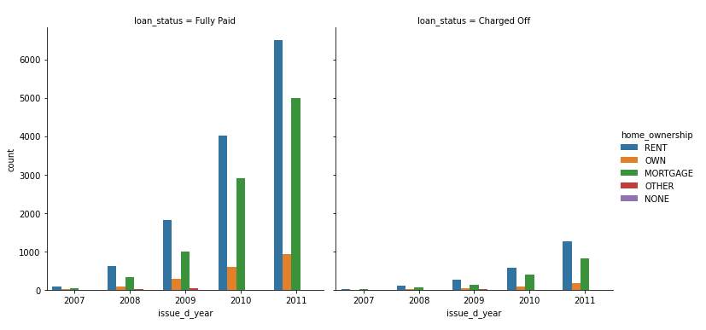
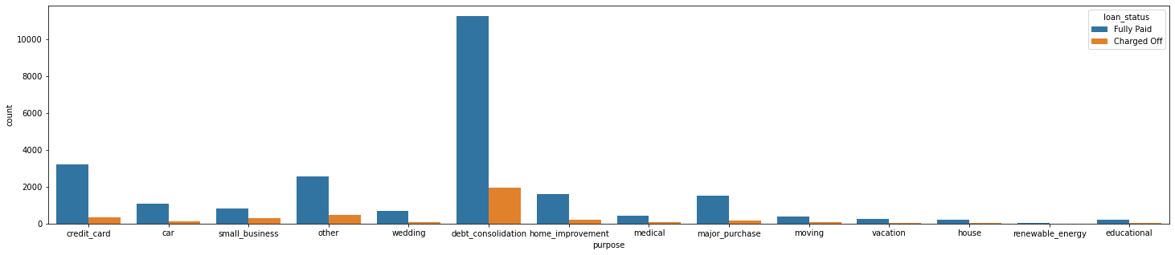
Lifestyle Analysis
People on Rent and Mortgage apply for loans the most.
People who own a home tend to Default lesser.
Most of loans are for debt consolidation.

Slide 11
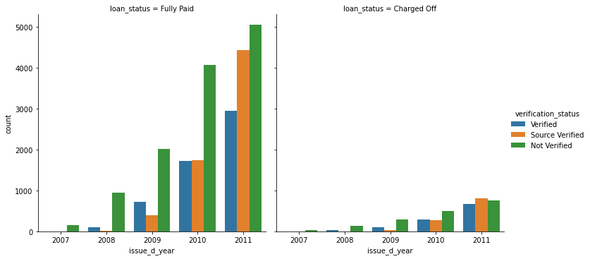
Verification Analysis
During the starting days of the company, it dint focus on Verification Status which is reflected in the Charged off in Year 2008.
As the company aged, significant improvements in Verified and Source Verified loan.

Slide 12
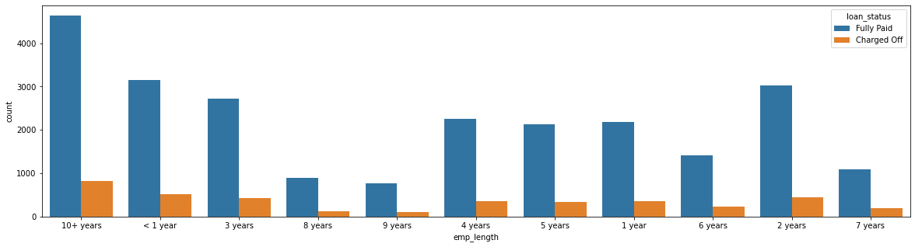
Employee Experience Analysis
People after starting career till 5 years apply for loans
People with experience from 6 years – 9 years have good chances to Fully Pay the loans.
People after 10+ years of experience apply for loans the most and they tend to fully pay back
But this bracket, there is a caveat 10 years+ employees will also include exp of 15,20,25 people but others are individual.

Slide 13
Conclusions

